Slide 1
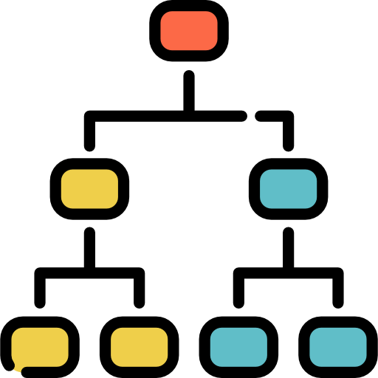


2022
Customer Churn Analysis and Prediction
The Team Members:
Anisa Ramadhani, S.Stat.
Ghifari, S.Kom.
Nurul Syiffa Yulianti, S.T.
Charlie Inc.

Slide 2
Outline
Charlie Inc.
2022
1
6
Data Splitting and Data Preprocessing
Business Problem Understanding
7
Model Benchmarking and Modeling on Test Data
2
Data Understanding
3
8
Hyperparameter Tuning
Initial Data Analysis and Data Cleaning
4
9
Feature Importance
Test Statistic
5
10
Conclusion
Exploratory Data Analysis (EDA)
11
Recommendation

Slide 3
Business Problem Understanding
1
Role: E-Commerce Consultant
1. Churned customers may cause company loss
due to missing potential orders and purchases
2. Mistargeted Investments by the company may also
decrease profits and increase losses
Our Recommendation : Churn Prediction
- Classification Target 1 = Churn
- Classification Target 0 = Not Churn
4
1
Context
Method: Supervised Machine Learning ->Classification
Analytic Approach
F1 Score
5
Metric Evaluation
2. What business strategy is more suitable to minimize customer churn?
2
1. What factors influence customer Churn behavior?
Problem Statement
Assumptions:
Churned customers are the customers who delete their account.
The E-Commerce presumably located in India because UPI (Unified Payments Interface) in the dataset may refer to payment service that integrates the services of banks in India on a single application.
1. Identify the factors that may cause customer churn and predict the customer churn potential
2. Analyze business strategies to minimize losses by using vouchers to minimize customer churn.
3
Goals

Slide 4
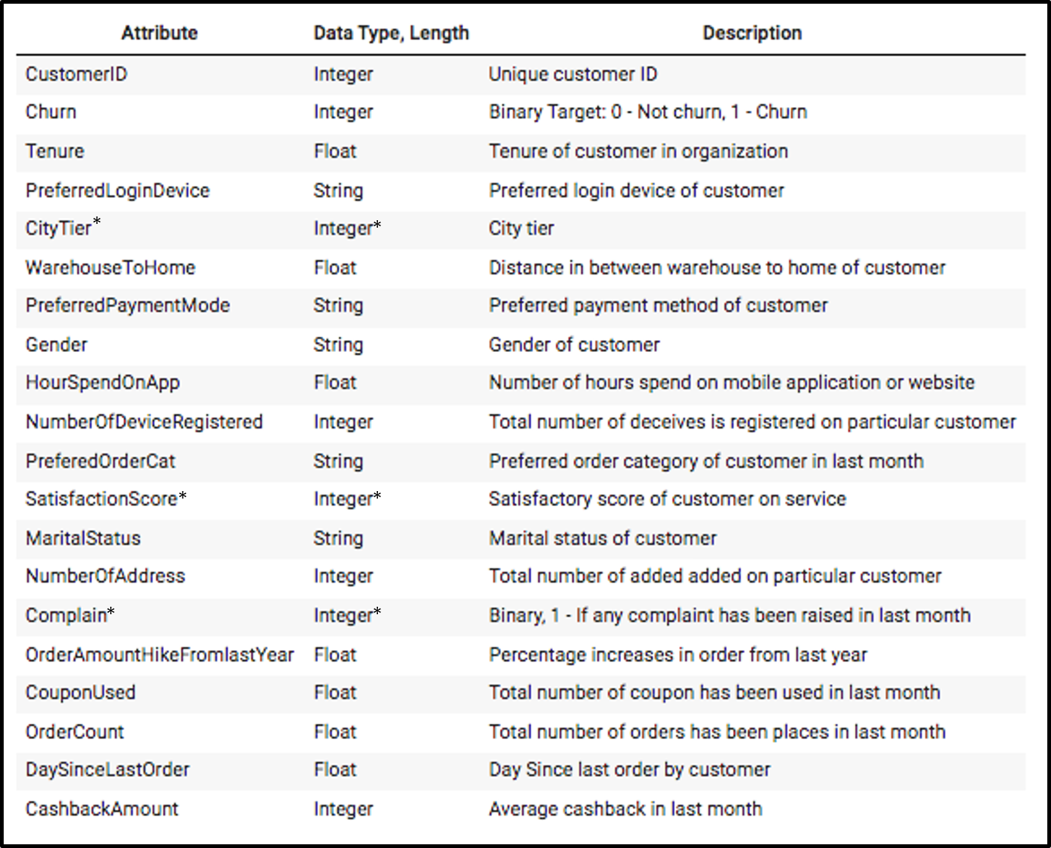
Data Understanding
2
Assumptions:
Month
1
Some features are categorical (Nominal, Ordinal, Binary), with somewhat low cardinality. The highest cardinality contains 7 unique values
Kilometer
(Daily Average)
2
There are some redundant unique values where 2 values has similar meaning, we can merge them into a single value to reduce the cardinality
3
Every row represents exactly 1 customer, whether it be churned ones or still active customers
INR
* Categorical features which don’t need to be encoded

Slide 5
Data Understanding
2
Total data: 5630 rows, 20 columns
Data types :
float (7 columns),
integer (8 columns),
object (5 columns).
Categorical Features
Numerical Features
Target
* Categorical features which don’t need to be encoded

Slide 6
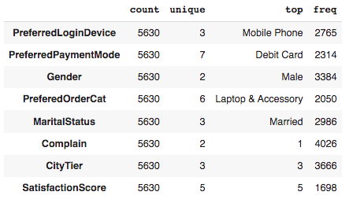
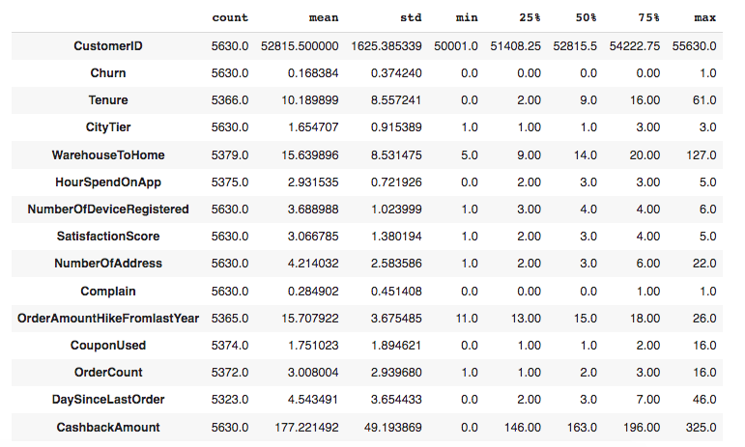
Data Understanding
2
Categorical Descriptive Statistic
Numerical Descriptive Statistic
*
*
*
*
*
*
Feature with highest cardinality (7 unique values) : PreferredPaymentMode
Features with lowest cardinality (2 unique values/binary) : Gender, Complain
Max Tenure = 61 (month)
Max HourSpendOnApp = 5 (daily average)
* Categorical features which don’t need to be encoded

Slide 7
Initial Data Analysis and Data Cleaning
3
Delete unique ID; Delete duplicated rows; Delete category redundancy;
Drop Unique Identifier
- - - - -
Unique identifier will not be used for analysis and modeling
Drop Duplicated Rows
- - - - -
Duplicated rows may caused overfit or information leakage
1 column dropped: ‘CustomerID’
Merge Redundant Values
- - - - -
Merge similar values to a single value
556 duplicated rows deleted
Clean Data
=
Good Model
Mobile, Phone & Mobile Phone
CC & Credit Card
COD & Cash on Delivery

Slide 8
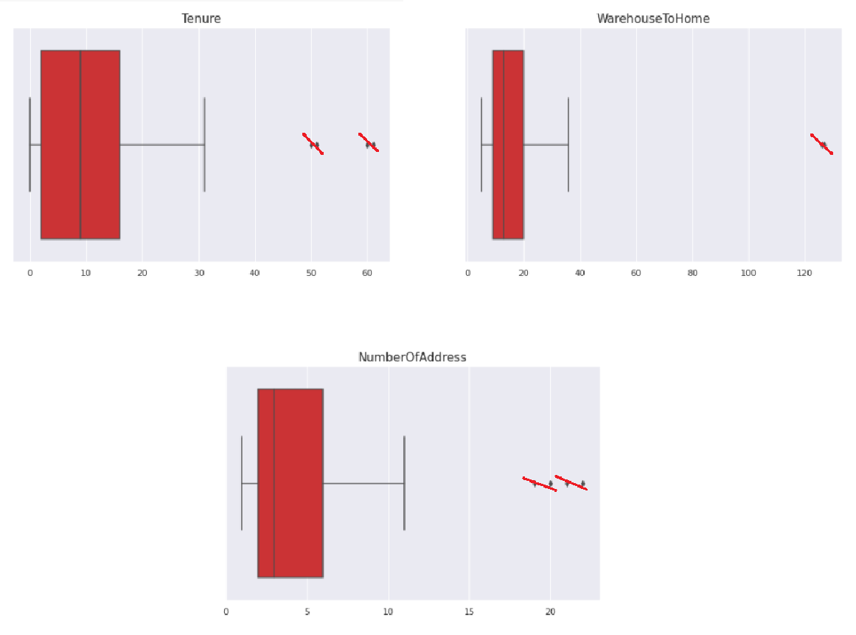
Initial Data Analysis and Data Cleaning
3
Handling Outliers
4 data points have tenure far longer than the others, but they only have very few orders (3 max), also their last order is also not too long ago.
1
2
2 data points have home very far away from the nearest warehouse. Due to the far distance and the very few amounts, these outliers can be deleted.
3
4 data points had input many addresses on their app, however they only did 2 orders maximum.
These outliers are few and very far from the rest of the observations, so we can delete these outliers in particular..
Total data:
Before dropping duplicates and outliers: | 5630 rows, 20 columns
After dropping duplicates and outliers: | 5064 rows, 19 columns

Slide 9
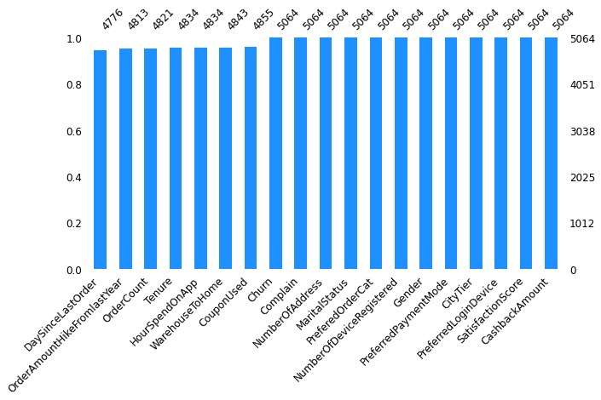
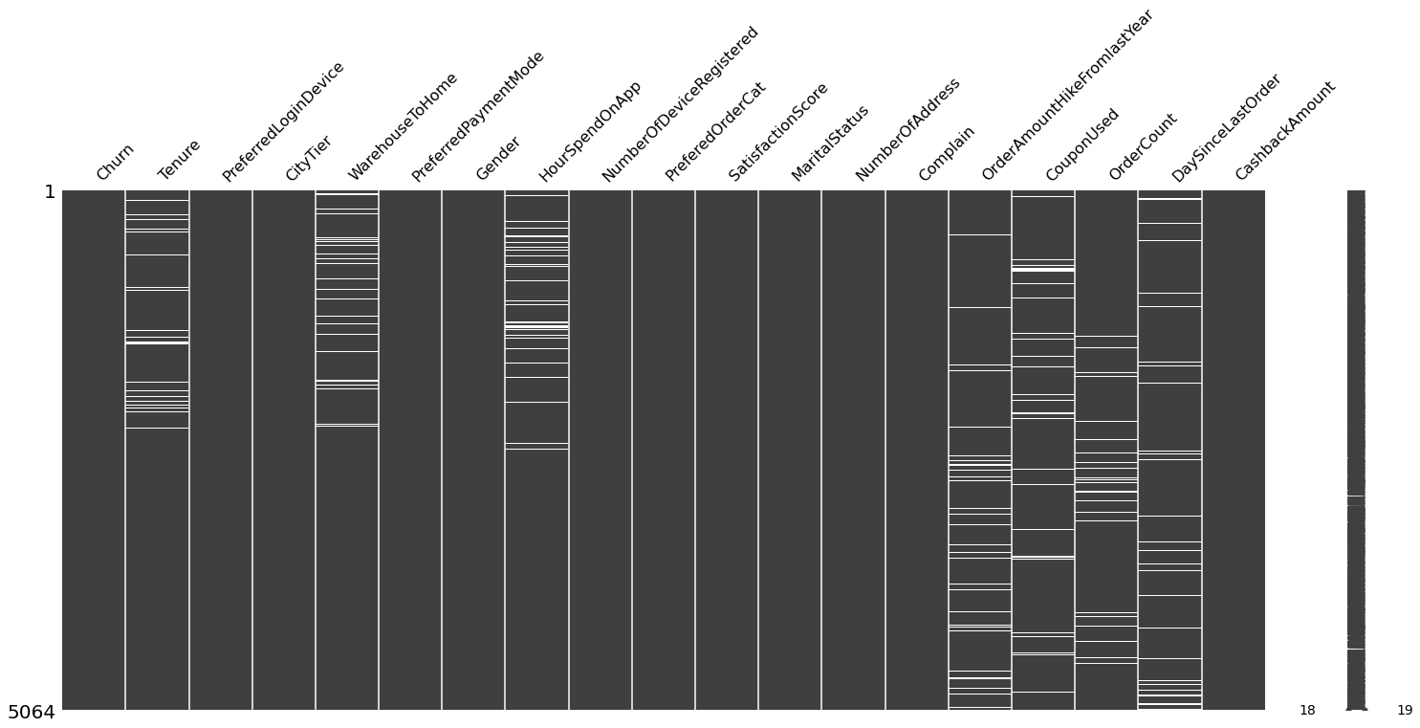
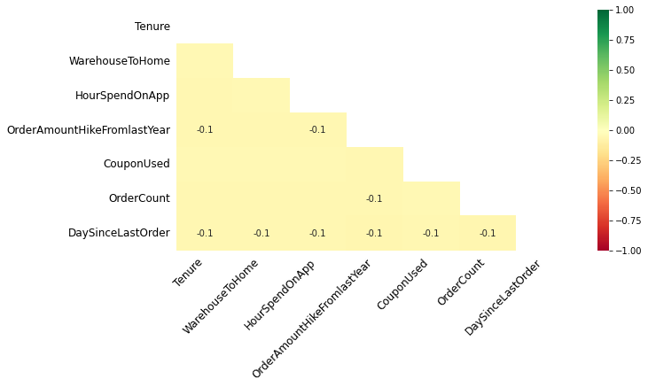
Initial Data Analysis and Data Cleaning
3
Identify Missing Values
(a)
(b)
(c)
Missing Value : DaySinceLastOrder, OrderAmountHikeFromLatyear, OrderCount,Tenure, HourSpendOnApp, WarehouseToHome, CouponUsed (a)
Missing values’ pattern are random (b) and not correlated one another (c).

Slide 10
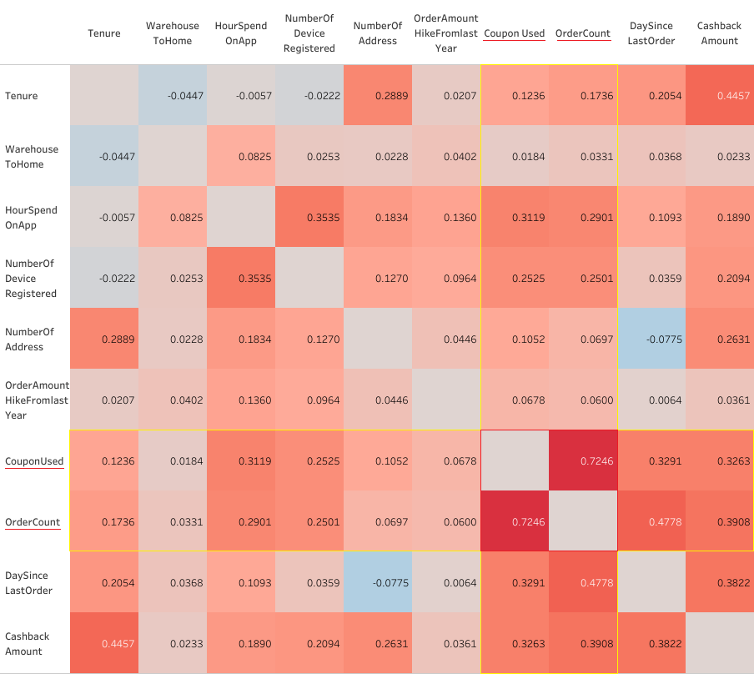

Initial Data Analysis and Data Cleaning
3
Handling Missing Values
'CouponUsed' & 'OrderCount'
are the only features that are strongly correlated (0.72)
-> both will be iteratively imputed

Slide 11
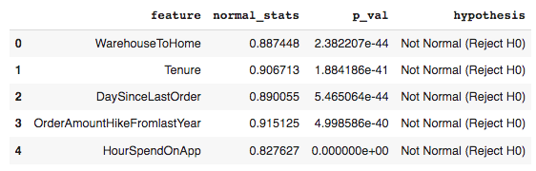
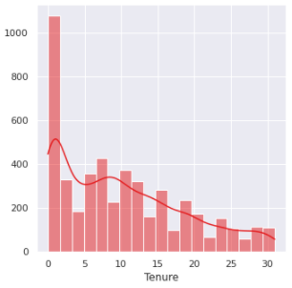
Initial Data Analysis and Data Cleaning
3
Handling Missing Values
Normality Test
The rest of the features containing missing values have non-normal distribution, including:
'DaySinceLastOrder'
'WarehouseToHome'
'Tenure'
'OrderAmountHikeFromlastYear'
'HourSpendOnApp'
-> they all will be imputed with their respective ‘median’ values
After being imputed, there are no more
missing values

Slide 12
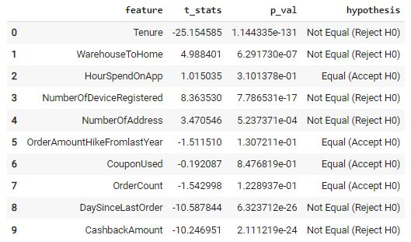
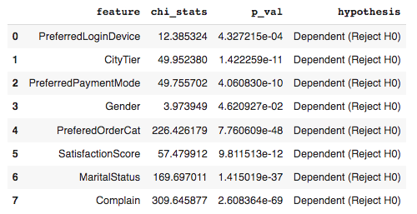
Test Statistic
4
Two Sample Independent T-Test
Chi-Square
Hypothesis:
Ho: The average value of non churn equals the one that is churn from 1 feature Ha: The average value of non churn does not equal the one that is churn from 1 feature
Hypothesis: Ho: Feature does not affect the target (churn) Ha: Feature affects the target (churn)
Conclusion: P-Value is lower than the significance level (0.05) = we have sufficient evidence to reject the Ho.
>> numeric features that have different mean between churn and not churn: Tenure, WarehouseToHome, NumberOfDeviceRegistered, NumberOfAddress,
DaySinceLastOrder, dan CashbackAmount.
Conclusion: P-Value is lower than the significance level (0.05) = we have sufficient evidence to reject the Ho.
>> all categorical features affect ‘Churn’.

Slide 13
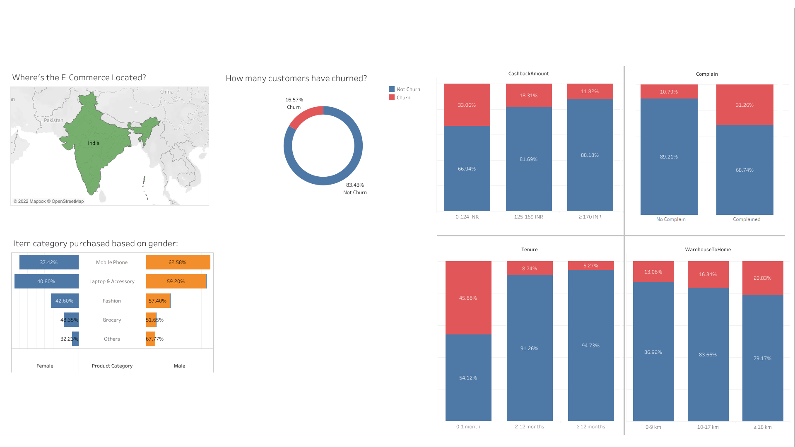
Exploratory Data Analysis
5
More customers purchased 'mobile phone' and 'laptop & accessory' than the other categories.
Male customers purchased more items than female customers in general.
Customers are more likely to churn when they have lower cashback and tenure.
Customers are more likely to churn when they have reported a complaint.
Customers are more likely to churn when they have further distance from their home to the nearest warehouse.
Created in Tableau; Charlie Inc. 2022

Slide 14
Data Splitting & Preprocessing
6
Data Splitting
TRAIN SET : TEST SET
80% : 20%
Data Preprocessing
One Hot Encoding
Binary Encoding
(≤4 unique values)
(>4 unique values)
PreferredLoginDevice
Gender
MaritalStatus
PreferredPaymentMode
PreferredOrderCat

Slide 15
Modeling
7
Model Benchmark: Train Set
Test Set
Model | Mean F1-Score | Std
LightGBM | 0.874574 | 0.025805
Random Forest | 0.870420 | 0.029388
Decision Tree | 0.820771 | 0.021130
Adaptive Boosting | 0.820761 | 0.027525
Gradient Boosting | 0.707085 | 0.052768
XGBoost | 0.684257 | 0.044418
Logistic Regression | 0.571417 | 0.067113
KNN | 0.473248 | 0.048200
Model | F1-Score
LightGBM | 0.865031
Random Forest | 0.867925
From the results above, Random Forest and LightGBM give a higher F1-score compared to other models
After fitting the model to test set, there is no big difference between the two models F1-score. Next, hyperparameter tuning will be performed on both models to improve their performance.

Slide 16
Hyperparameter Tuning
8
PARAMETER
LightGBM
'model__max_bin'
'model__num_leaves'
'model__min_data_in_leaf'
'model__num_iterations'
'model__learning_rate'
Model | F1-Score Before Tuning |  | F1-Score After Tuning
 | Train Set | Test Set | Train Set | Test Set
LightGBM | 0.874574 | 0.865031 | 0.910657 | 0.901493
Random Forest | 0.870420 | 0.867325 | 0.886497 | 0.875379
Random Forest
'model__n_estimators’
'model__criterion'
'model__max_features'
'model__max_depth'
'model__min_samples_split'
'model__min_samples_leaf'
'model__bootstrap'
Based on the results of hyperparameter tuning, the best model obtained is LightGBM because it has a higher F1-score.

Slide 17
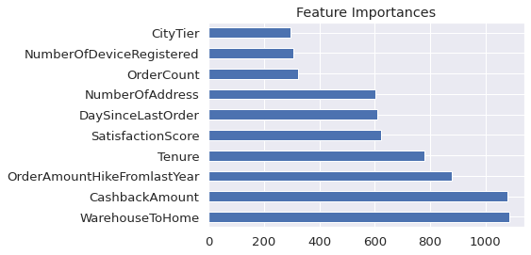
Feature Importances
9
Based on the graph, it can be seen that the most important features are ‘WarehouseToHome’ and ‘CashbackAmount’.

Slide 18
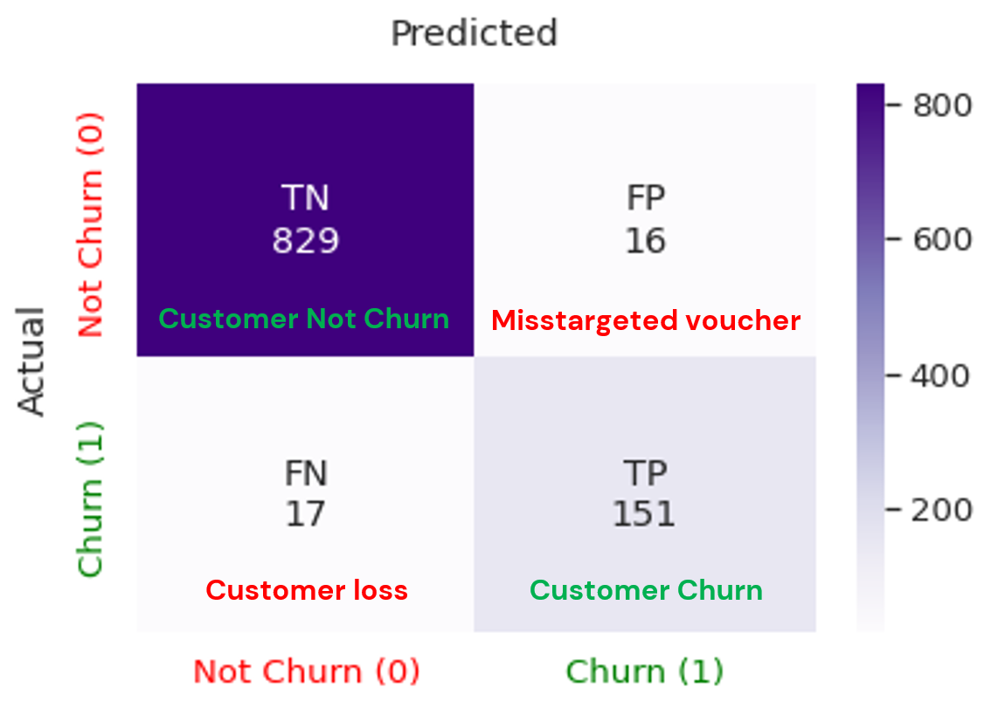
Conclusion
10
Our model predicted:
980 correct predictions. The model correctly predicted 829 Non-churn customers and 151 churned customers (TN + TP)
16 non-churn customers predicted as churned (FP), this error will cost 16 vouchers given to the wrong target
17 churned customers predicted as not churn (FN), this error will cause 17 customers not receiving any voucher to prevent them from churn
Churn Prediction Classification Report
Churn Prediction Confusion Matrix
Actual Received Cashback Amount
Classification | PRECISION | RECALL | F1-SCORE
1 | 0.90 | 0.90 | 0.90
0 | 0.98 | 0.98 | 0.98
Churn Class | Cashback Average
Low churn probability | 162.0
Medium churn probability | 145.4
High churn probability | 162.3
Predicted not churn | 180
1 = Churn ; 0 = Not Churn

Slide 19
Cost Benefit Analysis
10
Assumptions:
Total 1013 customers; 845 not churn; 168 churn.
Average Cashback Amount (not churn) = 180 INR per customer
Cost for voucher = 190 INR per customer.
Cost for voucher divided into class (per customer)
= Low; 180 INR, Medium; 185 INR, High; 190 INR.
e. Loss due to customer churn :
2 order per customer * 500 INR
= 1000 INR per customer.
Without model
Prediction using LGBM
Distinguish voucher amount based on churn probability
Total cost for voucher:
190 INR * 1013 cust =
192.470 INR
Total cost for voucher:
190 INR * (151+16) cust
31.730 INR
Low Churn Probability:
Total Cost: 6 cust * 180 INR = 1.080 INR
Total Loss: 4 cust * 180 INR = 720 INR
Total cost for voucher:
31.635 INR
Saves around 83.5%
Saves around
0.3%
Medium Churn Probability:
Total Cost: 7 cust * 185 INR = 1.295 INR
Total Loss: 4 cust * 185 INR = 740 INR
Total loss (mistargeted voucher):
190 INR * 845 cust =
160.550 INR
Total loss:
(190 INR * 16 cust) + (1000 INR * 17 cust)
20.040 INR
Total loss:
2.980 INR + (17 cust * 1000 INR)
19.980 INR
High Churn Probability:
Total Cost: 154 cust * 190 INR = 29.260
Total Loss: 8 cust * 190 INR = 1.520 INR

Slide 20
11
Recommendation
1
Analyze the possible cause behind why is the test score often higher than the train score.
4
More research is needed regarding the current E-Commerce business strategy related to ‘WarehouseToHome’.
5
Try other Machine Learning algorithms and do hyperparameters tuning again to get better result.
2
Add more data and gather more information to strengthen assumptions that have been made.
3
6
More thorough analysis on the wrong prediction result.
Add more features related to the amount customers spend on the E-Commerce. The added features may improve model performance and assist in determining strategies to reduce customer churn.
7
Identify the direction of the feature's relationship to the target by using Shap library.

Slide 21




Charlie Inc.
2022
Thank you!
Any Question?

